Slide 1


NSOP 2024
IPR #4
Air Force ROTC Detachment 842
The University of Texas at San Antonio
C/Llanas, C/Parry, & C/Griffin
29 JUL 24

Slide 2


Overview
Completed
To Be Completed
Detailed NSOP Schedule
Leads/Representatives
Rooms (Reserved)
Logistics
Summary
Air Force ROTC Detachment 842 • We Build Exceptional Officers • The University of Texas at San Antonio

Slide 3
Completed
Initial Email/Slack Invitational 22 Jul 24
Logistics Spreadsheet 22 Jul 24
Volunteers Sign-Up 2 Aug 24
GLPs (3) for FCs 9 Aug 24
Detailed Schedule (Draft #1)
Snack/Water Order
Wristbands Purchased
Air Force ROTC Detachment 842 • We Build Exceptional Officers • The University of Texas at San Antonio

Slide 4
To Be Completed
C/Llanas
Official NSOP Info Email 29 Jul 24
Flight Rosters 1 Aug 24
Draft PPT Presentations 3 Aug 24
Finalized Volunteer List 8 Aug 24
Finalized PPT Presentations 10 Aug 24
C/Griffin
Finalized NSOP Schedule
5 Aug 24
C/Parry
First Aid Kit Check Out
POC RoundUp
Costco Run
20 Aug 24
Print Signs/Schedules/GLPs
21 Aug 24
Air Force ROTC Detachment 842 • We Build Exceptional Officers • The University of Texas at San Antonio

Slide 5
Detailed NSOP Schedule
Aug 22nd – Main Auditorium (Cadre Led):
0700-0755: Volunteers Arrive/Set-Up
0800-0900: In-Processing
Main Auditorium -> Transition To SSgt. Taylor
0905-0920: Commander’s Introduction/Intent
0925-1140: Cadre Introductions/Paperwork/Wings Breakdown
1145-1200: Questions for Cadre/Prospects Dismissed
1205-1300: Volunteers Clean-Up
Aug 23rd – Main Auditorium (Cadet Led):
0700-0755: Volunteers Arrive/Set-Up
0800-0900: In-Processing/Check-In
Main Auditorium: Flight Time/Introductions
0900-0910: Wrap Up/Transition
Group Rotations:
0915-10:00, 10:05-1050, 1055-1140
Alpha/Bravo/Charlie: Sports Physicals/GLPs -> LRS -> Tour
Delta/Whiskey/Xray: LRS -> Tour -> Sports Physicals/GLPs
Yankee/Zulu: Tour -> Sports Physical/GLP -> LRS
1145-1200: Wrap Up/Transition To Main Auditorium
1200-1300: Club/Wingstaff Introductions (8 min. max)
1300: Prospects Dismissed
Air Force ROTC Detachment 842 • We Build Exceptional Officers • The University of Texas at San Antonio

Slide 6
Leads/Representatives
About 9 Leads
C/Llanas
Check-in:
Height/Weight:
LRS:
C/Griffin
Ushers:
Tour Guides:
Physicals:
C/Parry
Guides:
Runners:
Public Affairs: C/Douglas
23 August 24 (Friday) Speakers
Wingstaff Representative(s)
Booster:
AAS:
Honor Guard:
Victory:
I5:
Silver Wings:
*Names will be added 03 Aug 24*
Air Force ROTC Detachment 842 • We Build Exceptional Officers • The University of Texas at San Antonio

Slide 7
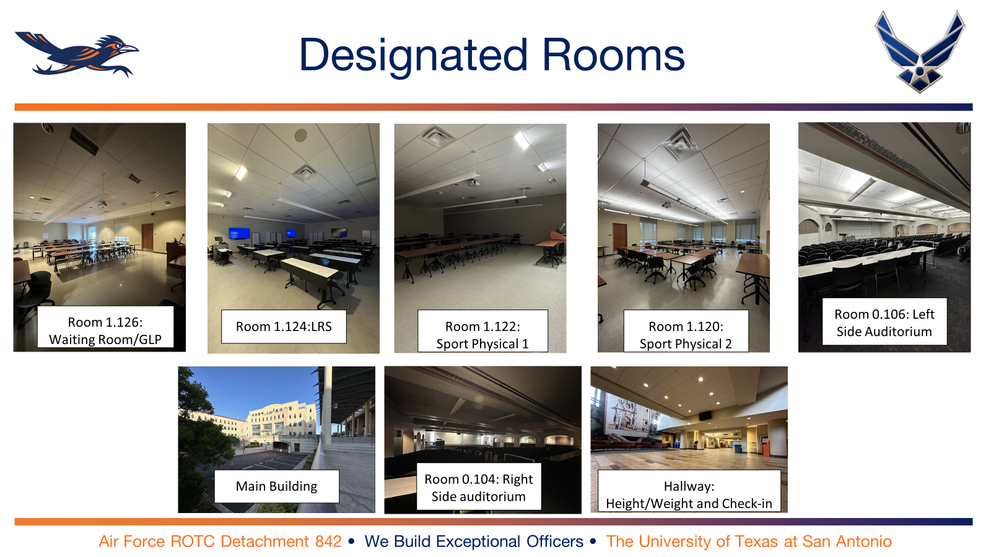
Rooms to Reserve

Slide 8
Logistics
Updates
Snacks (Granola Bar/Fruit Snacks)
Waters (4-40 pack)
Wristbands (Bought)
First Aid Kit (POC Roundup)
Things to Print
Directional Signs
Slack QR Code
GLPs/Eval Sheets
NSOP Schedule
Wristband Sheet
https://docs.google.com/spreadsheets/d/1rEr63bXIn7s8EHRjMp0Ynnc9w5Q-SlhDJrKJ7KngOXs/edit?usp=sharing
Air Force ROTC Detachment 842 • We Build Exceptional Officers • The University of Texas at San Antonio

Slide 9
Summary
Completed
To Be Completed
Detailed NSOP Schedule
Leads/Representatives
Rooms (Reserved)
Logistics
Summary
Air Force ROTC Detachment 842 • We Build Exceptional Officers • The University of Texas at San Antonio

Slide 10
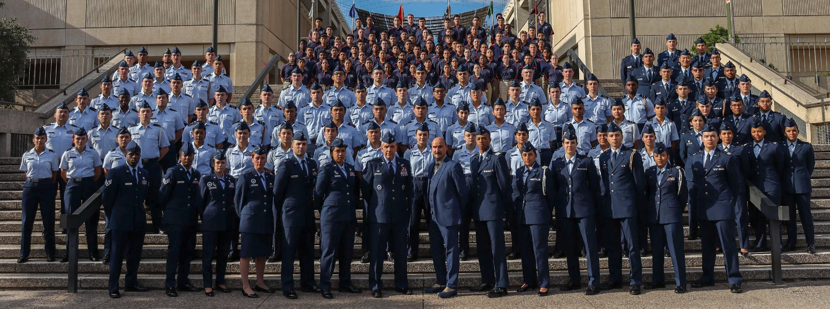
Air Force ROTC Detachment 842
The University of Texas at San Antonio
Det 842 – Best in Blue

